Slide 1
Accounting Principles, 7th Edition
Weygandt • Kieso • Kimmel
Chapter 12
Accounting Principles
Prepared by Naomi Karolinski
Monroe Community College
and
Marianne Bradford
Bryant College
John Wiley & Sons, Inc. © 2005

Slide 2
CHAPTER 12 ACCOUNTING PRINCIPLES
After studying this chapter, you should be able to:
1 Explain the meaning of generally accepted accounting principles and identify the key items of the conceptual framework.
2 Describe the basic objectives of financial reporting.
3 Discuss the qualitative characteristics of accounting information and elements of financial statements.

Slide 3
CHAPTER 12 ACCOUNTING PRINCIPLES
After studying this chapter, you should be able to:
4 Identify the basic assumptions used by accountants.
5 Identify the basic principles of accounting.
6 Identify the two constraints in accounting.
7 Explain the accounting principles used in international operations.

Slide 4
CONCEPTUAL FRAMEWORK OF ACCOUNTING
STUDY OBJECTIVE 1
Generally accepted accounting principles
  set of standards and rules that are recognized as a general guide for financial reporting
Generally accepted
  means that these principles must have substantial authoritative support
Financial Accounting Standards Board (FASB) and Securities and Exchange Commission (SEC)
The FASB has the responsibility for developing accounting principles in the United States.
Notes:
2

Slide 5
FASB’S CONCEPTUAL FRAMEWORK
The conceptual framework developed by the FASB serves as the basis for resolving accounting and reporting problems.
The conceptual framework consists of:
1) objectives of financial reporting;
2) qualitative characteristics of accounting information;
3) elements of financial statements; and
4) operating guidelines (assumptions, principles, and constraints).
Notes:
3

Slide 6
OBJECTIVES OF FINANCIAL REPORTING
STUDY OBJECTIVE 2
FASB objectives of financial reporting are to provide information that is:
1 useful to those making investment and credit decisions
2 helps in assessing future cash flows
3 identifies the economic resources (assets), the claims to those resources (liabilities), and the changes in those resources and claims
Notes:
4

Slide 7
QUALITATIVE CHARACTERISTICS OF ACCOUNTING INFORMATION
STUDY OBJECTIVE 3
To be useful, information should possess the following qualitative characteristics:
1 relevance
2 reliability
3 comparability
4 consistency
Notes:
5

Slide 8
RELEVANCE
Accounting information has relevance if it makes a difference in a decision.
Relevant information helps users forecast future events (predictive value), or it confirms or corrects prior expectations (feedback value).
Information must be available to decision makers before it loses its capacity to influence their decisions (timeliness).
Notes:
6

Slide 9
RELIABILITY
Reliability of information means that the information is free of error and bias, in short, it can be depended on.
To be reliable, accounting information must be verifiable.
Notes:
7

Slide 10

COMPARABILITY AND CONSISTENCY
Comparability means that the information should be comparable with accounting information about other enterprises.
Consistency means that the same accounting principles and methods should be used from year to year within a company.
2005
2006
2007
Notes:
8

Slide 11
QUALITATIVE CHARACTERISTICS OF ACCOUNTING INFORMATION
Useful
Financial
Information has:
Relevance
Reliability
1 Predictive value
2 Feedback value
3 Timeliness
1 Verifiable
2 Faithful representation
3 Neutral
Comparability
Consistency
Notes:
9

Slide 12
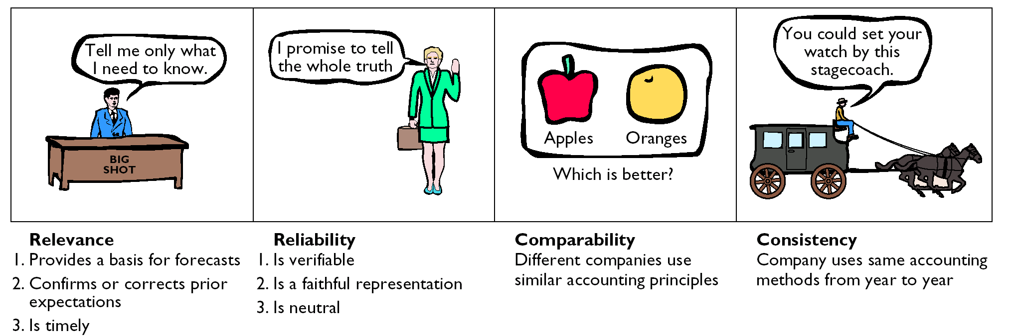
CHARACTERISTICS OF USEFUL INFORMATION

Slide 13
THE OPERATING GUIDELINES OF ACCOUNTING
Operating guidelines are classified as assumptions, principles, and constraints.
Assumptions provide a foundation for the accounting process.
Principles indicate how transactions and other economic events should be recorded.
Constraints on the accounting process allow for a relaxation of the principles under certain circumstances.
Assumptions
Principles
Constraints
Monetary unit Economic entity Time period Going concern
Revenue recognition Matching Full disclosure Cost
Materiality Conservatism
Notes:
10

Slide 14
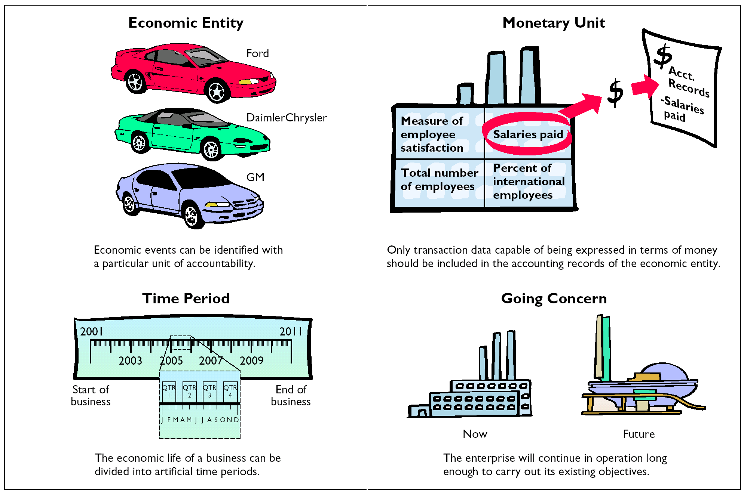
ASSUMPTIONS
USED IN ACCOUNTING

Slide 15
The primary criterion by which accounting information can be judged is:
Review
consistency.
predictive value.
decision-usefulness.
comparability.

Slide 16
The primary criterion by which accounting information can be judged is:
Review
consistency.
predictive value.
decision-usefulness.
comparability.

Slide 17
ASSUMPTIONS
STUDY OBJECTIVE 4
Monetary unit assumption:
  only transaction data expressed in terms of money can be included in the accounting records
Example: employee satisfaction and percent of international employees are not transactions that should be included in the financial records.
Customer Satisfaction
Percentage of International Employees
Salaries paid
Should be included
in accounting records
Notes:
11

Slide 18


ECONOMIC ENTITY ASSUMPTION
Activities of the entity kept separate
and distinct from the activities of the owner
and all other economic entities.
Example: BMW activities can be distinguished from those of other car manufacturers such as Mercedes.
Notes:
12

Slide 19
TIME PERIOD ASSUMPTION
Economic life of a business divided into
artificial time periods.
2005 2006 2007
QTR 1
QTR 2
QTR 3
QTR 4
JAN FEB MAR APR MAY JUN JUL AUG SEPT OCT NOV DEC
Notes:
13

Slide 20


GOING CONCERN ASSUMPTION
Enterprise will continue in operation long enough to carry out its existing objectives.
Implications: depreciation and amortization are used, plant assets recorded at cost instead of liquidation value, items are labeled as fixed or long-term.
Notes:
14

Slide 21
PRINCIPLES
REVENUE RECOGNITION
STUDY OBJECTIVE 5
Revenue recognition principle
  dictates that revenue should be
  recognized in the accounting
  period in which it is earned.
When a sale is involved, revenue is recognized at the point of sale.
Notes:
15

Slide 22

PERCENTAGE-OF-COMPLETION METHOD OF REVENUE RECOGNITION
In long-term construction contracts, revenue recognition is usually required before the contract is completed.
The percentage-of-completion method recognizes revenue on the basis of reasonable estimates of progress toward completion.
A project’s progress toward completion is measured by comparing the costs incurred in a year to total estimated costs of the entire project.
Notes:
16

Slide 23
FORMULA TO RECOGNIZE REVENUE IN THE PERCENTAGE-OF-COMPLETION METHOD
Costs Incurred
(Current Period)
Total
Estimated
Cost
Percent
Complete
(Current Period)
÷
=
Percent
Complete
(Current Period)
Revenue
Recognized
(Current Period)
X
Total Revenue
=
Notes:
17

Slide 24
FORMULA TO COMPUTE GROSS PROFIT
IN CURRENT PERIOD
The costs incurred in the current period are then subtracted from the revenue recognized during the current period to arrive at the gross profit.
Revenue
Recognized
(Current
Period)
Gross Profit
Recognized
(Current
Period)
X
Cost Incurred
(Current
Period)
=

Slide 25
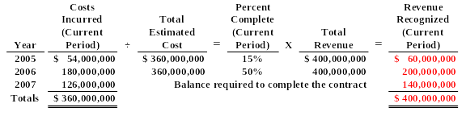
REVENUE RECOGNIZED
PERCENTAGE-OF-COMPLETION METHOD
Warrior Construction Co. has a contract to build a dam for $400 million. It will take 3 years (starting in 2005) at a construction cost of $360 million. Assume that Warrior incurs $54 million in 2005, $180 million in 2006, and $126 million in 2007 on the dam project. The portion of the $400 million of revenue recognized in each of the 3 years is shown below:

Slide 26
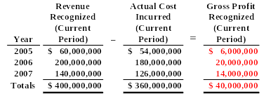
GROSS PROFIT RECOGNIZED
PERCENTAGE-OF-COMPLETION METHOD
The gross profit recognized each period for Warrior Construction Co. is as shown below. Use of the percentage-of-completion method involves some subjectivity. As a result, errors are possible in determining the amount of revenue recognized. To wait until completion would seriously distort the financial statements. If it is not possible to obtain dependable estimates of costs and progress, then the revenue should be recognized at the completion date and not by the percentage-of-completion method.

Slide 27



GROSS PROFIT FORMULA
INSTALLMENT METHOD
Under installment method, each cash collection from a customer consists of
1) a partial recovery of the cost of goods sold and
2) partial gross profit from the sale.
The formula to recognize gross profit is shown below.
Cash Collections from Customers
Gross Profit Recognized during the Period
x
Gross Profit Percentage
=

Slide 28
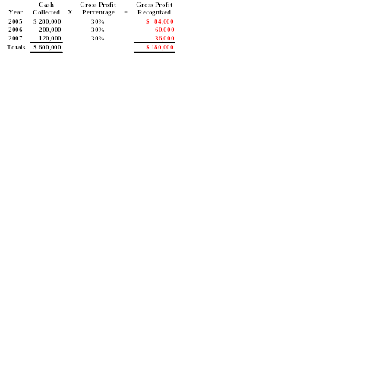
GROSS PROFIT RECOGNIZED
INSTALLMENT METHOD
An Iowa farm machinery dealer had installment sales in its first year of operations of $600,000 and a cost of goods sold on installment of $420,000. Therefore, total gross profit is $180,000 ($600,000 - $420,000), and the gross profit percentage is 30% ($180,000 ÷ $600,000). The collections on the installment sales were: First year, $280,000 (down payments plus monthly payments), second year, $200,000, and third year, $120,000. The collections of cash and recognition of the gross profit are summarized below (ignoring interest charges).

Slide 29
MATCHING
(EXPENSE RECOGNITION)
Expense recognition is traditionally tied to revenue recognition.
  referred to as the matching principle
  dictates that expenses be matched with revenues in the period in which efforts are made to generate revenues.

Slide 30
MATCHING (EXPENSE RECOGNITION)
PRINCIPLE
Unexpired costs become expenses in two ways:
Cost of goods
  merchandise inventory becomes expensed when
  the inventory is sold
2) Operating expenses
other unexpired costs through use or consumption or through the passage of time

Slide 31
EXPENSE RECOGNITION PATTERN
Operating expenses contribute to the revenues of the period but their association with revenues is less direct than for cost of goods sold.
Cost
Incurred
Provides No
Apparent Future
Benefits
Provides Future
Benefit
Benefits Decrease
Asset
Expense

Slide 32
FULL DISCLOSURE PRINCIPLE
Requires that circumstances and events that make a difference to financial statement users be disclosed.
Compliance with the full disclosure principle
1) data in the financial statements
2) notes that accompanying the statements
Summary of significant accounting policies usually the first note to the financial statements

Slide 33
COST PRINCIPLE
The cost principle dictates that assets be recorded at their cost.
Cost is used because it is both relevant and reliable.
1) Cost is relevant because it represents a) the price paid, b) the assets sacrificed, or c) the commitment made at the date of acquisition.
2) Cost is reliable because it is a) objectively measurable, b) factual, and c) verifiable.

Slide 34
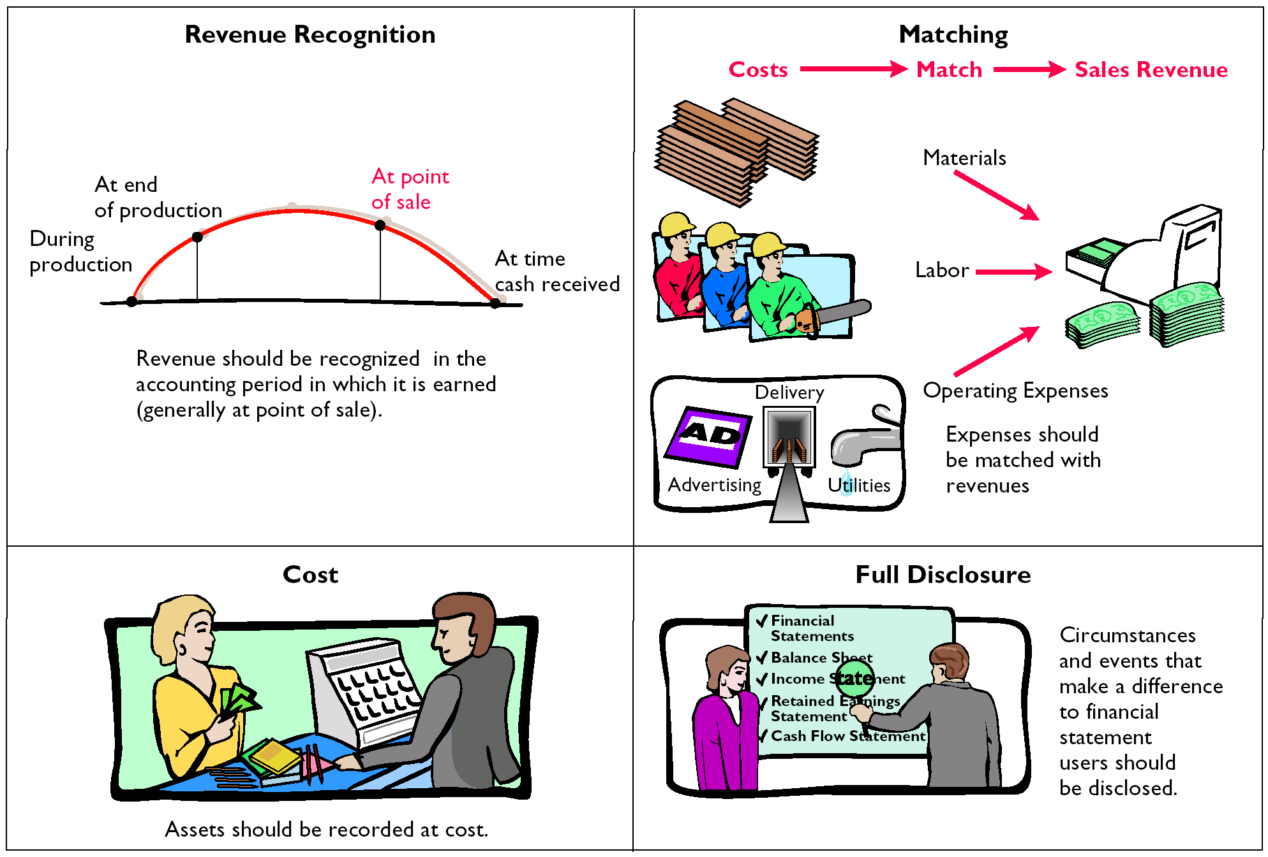
BASIC PRINCIPLES USED IN ACCOUNTING

Slide 35
CONSTRAINTS IN ACCOUNTING
STUDY OBJECTIVE 6
Two constraints
  Materiality
    relates to an item’s impact on a firm’s overall financial condition and operations.
  Conservatism
    dictates that when in doubt, choose the method that will be the least likely to overstate assets and income

Slide 36
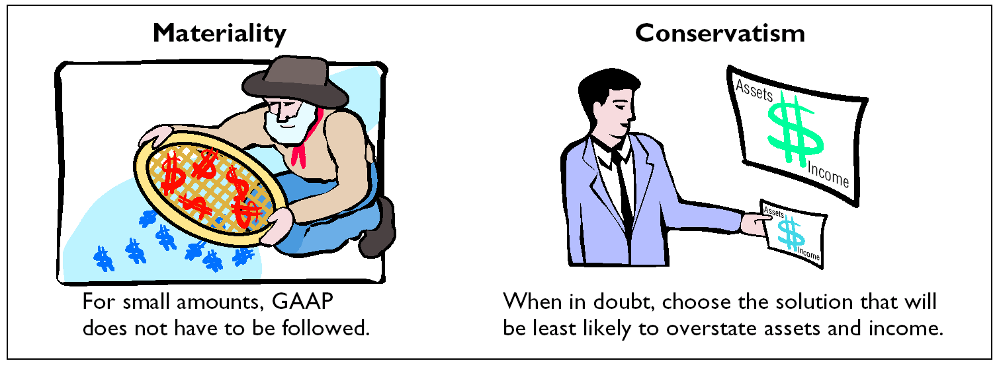
CONSTRAINTS IN ACCOUNTING

Slide 37



CONCEPTUAL FRAMEWORK
Objectives of Financial Reporting
Qualitative Characteristics of Accounting Information
Elements of Financial Statements
Operating Guidelines
Assumptions
Principles

Slide 38
FOREIGN SALES AND TYPE OF PRODUCT
STUDY OBJECTIVE 7
World markets are becoming increasingly intertwined, and foreigners consume American goods.
Americans use goods from many other countries.
Firms that conduct operations in more than one country through subsidiaries, divisions, or branches in foreign countries are referred to as multinational corporations.
International transactions must be translated into U.S. dollars.

Slide 39
The organization that issues international accounting standards is the:
Review
Financial Accounting Standards Board
International Accounting Standards Board.
International Auditing Standards Committee.
None of the above.

Slide 40
The organization that issues international accounting standards is the:
Review
Financial Accounting Standards Board
International Accounting Standards Board.
International Auditing Standards Committee.
None of the above.

Slide 41

CHAPTER 12 ACCOUNTING PRINCIPLES
Copyright © 2005 John Wiley & Sons, Inc. All rights reserved. Reproduction or translation of this work beyond that permitted in Section 117 of the 1976 United States Copyright Act without the express written consent of the copyright owner is unlawful. Request for further information should be addressed to the Permissions Department, John Wiley & Sons, Inc. The purchaser may make back-up copies for his/her own use only and not for distribution or resale. The Publisher assumes no responsibility for errors, omissions, or damages, caused by the use of these programs or from the use of the information contained herein.
Notes:
21

